Slide 1
Chapter 3:
Cells undergo chemical reactions

Slide 2
3.1 Metabolism
Metabolism
All cells carry out chemical processes that keep the organism alive.
All the chemical reactions that take place in cells, and therefore in the organism of which the cells are a part, are referred to as metabolism.
Metabolism is made up of two different types of chemical reaction:
Catabolic metabolism is the reactions in which large molecules are broken down to smaller ones, a process known as catabolism. Digestion is an example of catabolism.
Anabolic metabolism is the reactions in which small molecules are built up into larger ones, a process known as anabolism. Protein synthesis is an example of anabolism.
Catabolic reactions release energy, whereas anabolic reactions require energy. Metabolism is concerned with maintaining a balance between energy release and energy utilisation.

Slide 3
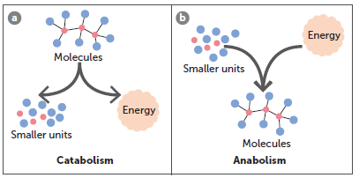
3.1 Metabolism

Slide 4
3.1 Metabolism
Nutrients
A nutrient is any substance in food that is used for growth, repair or maintaining the body; that is, any substance required for metabolism.
There are six groups of nutrients:
Water
Carbohydrates
Lipids
Proteins
Minerals
Vitamins.

Slide 5
3.1 Metabolism
Organic compounds
Organic compounds are molecules that have a carbon chain. They also contain a number of hydrogen atoms and can include atoms of oxygen, nitrogen and sulfur.
Carbohydrates
Carbohydrates are the main source of energy for cells.
Simple sugars (monosaccharides), particularly glucose, are used in cellular respiration to release energy.
Complex carbohydrates, such as starch, are broken down to simple sugars.
All carbohydrates contain atoms of carbon, hydrogen and oxygen.
Simple sugars can join together to form larger molecules (disaccharides).
Polysaccharides are larger carbohydrate molecules formed when many simple sugars join together.

Slide 6
3.1 Metabolism
Lipids
Lipids include fats and oil and are another important energy source. They are broken down to fatty acids and glycerol.
Glycerol is broken down to release energy in a similar way to glucose.
Each lipid molecule consists of one molecule of glycerol and one, two or three fatty acid molecules.

Slide 7
3.1 Metabolism
Proteins
Proteins are organic compounds that are made up of many amino acids. The most import
An amino acid is a molecule that contains an amino group and a carboxylic acid group.
When two amino acids bond together, these two groups react to form a peptide bond, releasing a water molecule. There are 20 different amino acids found in proteins, proteins, each one differing in the structure of the side chain.
Proteins consist of 100 or more amino acids; their type and order are determined by the DNA that codes for the protein’s production. Each protein has a characteristic shape due to the folding of the chain.
Shorter lengths of amino acids include dipeptides and polypeptides.

Slide 8
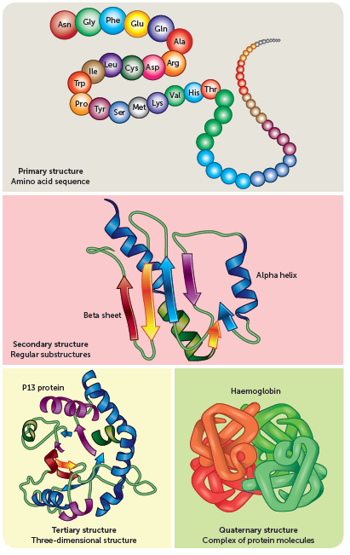
3.1 Metabolism

Slide 9
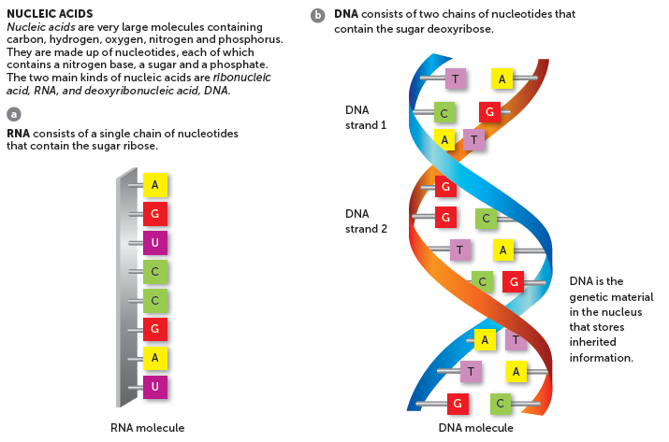
3.1 Metabolism
Other organic compounds include nucleic acids such as ribonucleic acid (RNA) and deoxyribonucleic acid (DNA).

Slide 10
3.1 Metabolism
Inorganic compounds
Inorganic compounds are not based on a carbon chain. Most do not contain carbon atoms, but those that do, such as carbon dioxide, are small molecules.
Water
Water is important in metabolism because it is the fluid in which other substances are dissolved. Some of the cell’s chemical reactions occur in water, and in others water molecules actually take part in the reaction.
Minerals
Minerals are important for metabolism because they may be a part of enzymes, function as cofactors for enzymes, or be a part of substances such as adenosine triphosphate (ATP) that are involved in metabolism.
Vitamins
Vitamins act as coenzymes for many of the chemical reactions of metabolism.

Slide 11
3.2 Enzymes and metabolism
Enzymes
Enzymes are biological catalysts that are able to speed up chemical reactions by lowering the activation energy. They are not consumed or altered in the reaction.
The molecule on which an enzyme acts is called the substrate. Each enzyme will combine with only one particular substrate so is involved in only one specific reaction.
The enzyme and its substrate have characteristics that are complementary to one another; they have a shape and a structure that allow them to fit together.
The part of the enzyme molecule that combines with the substrate is called the active site. When the enzyme and substrate are combined, they are called an enzyme–substrate complex.
There are two models to describe enzyme action.

Slide 12
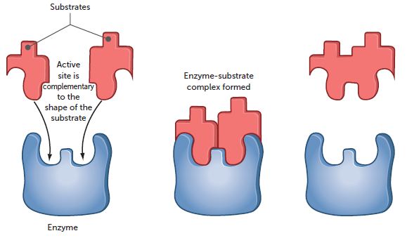
3.2 Enzymes and metabolism
1 Lock-and-key model
States that shape of the enzyme (the key) is always complementary to the shape of the substrate (the lock). Therefore, the two will fit exactly to form the enzyme–substrate complex.

Slide 13
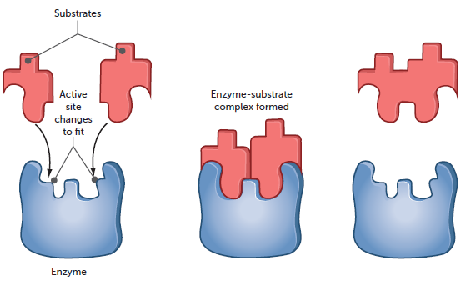
3.2 Enzymes and metabolism
1 Induced-fit model
States that when the enzyme and substrate join, they form weak bonds that cause the shape of the enzyme to change, creating complementary shapes.

Slide 14
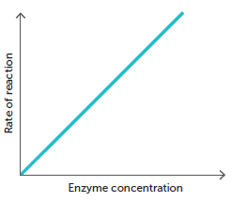
3.2 Enzymes and metabolism
Factors affecting enzyme activity
The activity of enzymes is dependent on the shape and availability of the active site. Therefore, the effect of enzymes is influenced by the following factors.
The higher the concentration of enzyme, the faster the rate of a chemical reaction because there are more enzyme molecules to influence reactants. By regulating the type and number of enzymes present, the body is able to control which reactions occur and the rate at which they proceed.

Slide 15
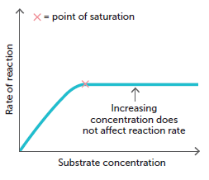
3.2 Enzymes and metabolism
Increasing substrate concentration also increases the rate of the reaction, because there will be more substrate molecules coming into contact with the enzyme molecules. Increasing the substrate beyond a certain concentration will cease to have an effect because the active sites on all the enzyme molecules will be fully occupied.
The products of the reaction must be continually removed, otherwise the rate of the reaction will slow because it becomes more difficult for the substrate molecules to make contact with the enzyme molecules.

Slide 16
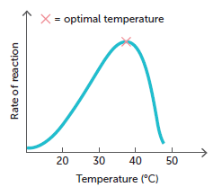
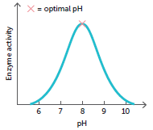
3.2 Enzymes and metabolism
Temperature influences enzyme activity. The rate of most chemical reactions increases as temperature increases. This is true of most enzyme reactions but only within a limited temperature range. Because enzymes are proteins, beyond about 45–50°C their structure changes; they are denatured. As the shape of the enzyme is crucial for its functioning, denatured enzymes are inactive. The optimum temperature for most enzymes in the human body is 30°C to 40°C.
Enzymes are very sensitive to the pH of the medium in which a reaction is taking place. Each enzyme has an optimum pH at which it will work most effectively.

Slide 17
3.2 Enzymes and metabolism
Many enzymes require the presence of certain ions or non-protein molecules before they will catalyse a reaction, called cofactors. Cofactors change the shape of the active site so that the enzyme can combine with the substrate. Without a cofactor the enzyme molecule is intact, but cannot function.
Enzyme inhibitors are substances that slow or even stop the enzyme’s activity. Inhibitors may be used by cells to control reactions so that products are produced in specific amounts. Many drugs are enzyme inhibitors, e.g. penicillin.

Slide 18
3.3 Cellular respiration
Cellular respiration
Cellular respiration is the process by which organic molecules, taken in as food, are broken down in the cells to release energy for the cell’s activities.
Cellular respiration can release energy from glucose, amino acids, fatty acids and glycerol, but the main food material utilised is glucose.
The breakdown of glucose to carbon dioxide and water involves 20+ separate reactions, which occur in a series. Small amounts of energy are released as the reactions proceed, so the release of energy is controlled rather than happening all at once.

Slide 19
3.3 Cellular respiration
Energy from cellular respiration
In the complete breakdown of glucose to carbon dioxide and water, about 60% of the available energy is released as heat. Cells cannot utilise heat energy, but it is important in keeping the body temperature constant.
The remaining energy is used to form a compound called adenosine triphosphate (ATP). ATP is composed of adenosine and three phosphate groups, and can be used to transfer energy between cellular respiration and processes in the cell requiring energy.

Slide 20
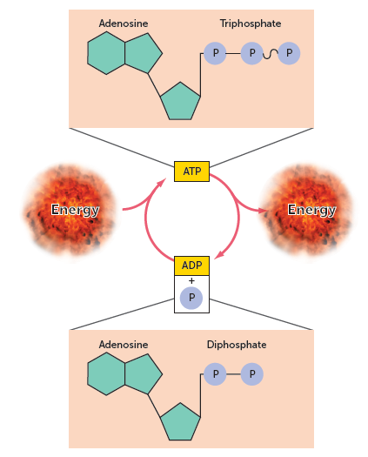
3.3 Cellular respiration

Slide 21
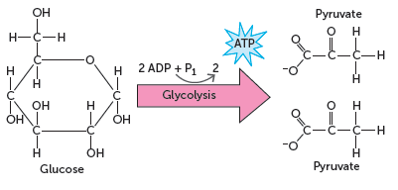
3.3 Cellular respiration
Glycolysis
The first phase in the breakdown of glucose does not require oxygen. It is called glycolysis, which means ‘splitting glucose’. A glucose molecule is broken down, in a series of 10 steps, to two molecules of pyruvate. Sometimes this molecule is called pyruvic acid; however, the two substances differ slightly in their structure.

Slide 22
3.3 Cellular respiration
Anaerobic respiration
If no oxygen is available, the pyruvate produced in glycolysis is then converted to lactic acid by fermentation. The production of lactic acid from glucose is called anaerobic respiration, which means respiration without oxygen.
The fermentation stage of anaerobic respiration does not produce any additional ATP; however, the glycolysis of one molecule of glucose releases enough energy to convert two molecules of ADP to ATP. Therefore, anaerobic respiration allows cells to produce some energy in the absence of oxygen.
The enzymes required for anaerobic respiration are available in the cytosol of the cell, therefore glycolysis and the conversion of pyruvate to lactic acid occur in the cytosol.
Anaerobic respiration is very important during vigorous physical activity, when the respiratory and circulatory systems are unable to supply muscle cells with enough oxygen to meet all the energy demands of the contracting muscles.

Slide 23
3.3 Cellular respiration
Aerobic respiration
The complete breakdown of glucose to carbon dioxide and water requires oxygen. The pyruvate produced from glycolysis is completely broken down to carbon dioxide and water. This is known as aerobic respiration – respiration requiring oxygen.
Aerobic respiration occurs in the mitochondria of the cell. To complete the breakdown of glucose, the two pyruvate molecules produced in glycolysis must enter a mitochondrion, where enzymes are available to allow the next series of reactions to occur.

Slide 24
3.3 Cellular respiration
The pyruvate is first converted to acetyl coenzyme A (acetyl CoA). No ATP is produced during this process.
The acetyl CoA then enters the citric acid cycle, also known as the Krebs cycle. Here the carbon atoms in the acetyl CoA are released in carbon dioxide. For every acetyl CoA that enters the citric acid cycle, one molecule of ATP is also produced. This means that two ATP molecules are produced per glucose molecule.
The final stage is the electron transport system; the only stage that uses oxygen (also called oxidative phosphorylation). Here electrons are passed between molecules, finally resulting in oxygen molecules forming water. Estimates of the exact number of ATP molecules that are produced range between 26 and 34 molecules. Therefore aerobic respiration of one molecule of glucose has the potential to generate up to 38 molecules of ATP.

Slide 25
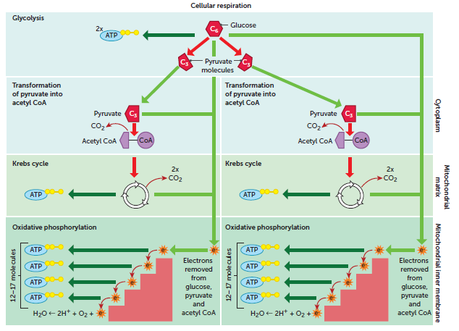
3.3 Cellular respiration
Summary of the processes of anaerobic and aerobic respiration

Slide 26
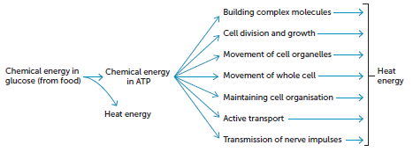
3.4 Energy use by the cell
Energy use by the cell
Cells need the energy that is temporarily stored in the ATP molecule for a variety of processes:
In cellular respiration, only about 40% of the energy released is incorporated into ATP; the other 60% is lost as heat. Therefore, energy must be continually consumed in the form of food to replace what is lost as heat and utilised for other purposes.

Slide 27
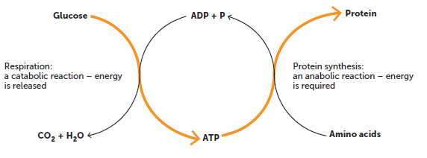
3.4 Energy use by the cell
The reactions of cellular respiration are catabolic; they release energy as larger molecules are broken down into smaller ones. ATP may be used to transfer energy produced in catabolic reactions to anabolic reactions that require energy. For example, when lactic acid is recombined with oxygen in the liver to form glucose.
Similarly, energy for the build-up of proteins, lipids and other molecules is transferred from cellular respiration by ATP.

